Slide 1
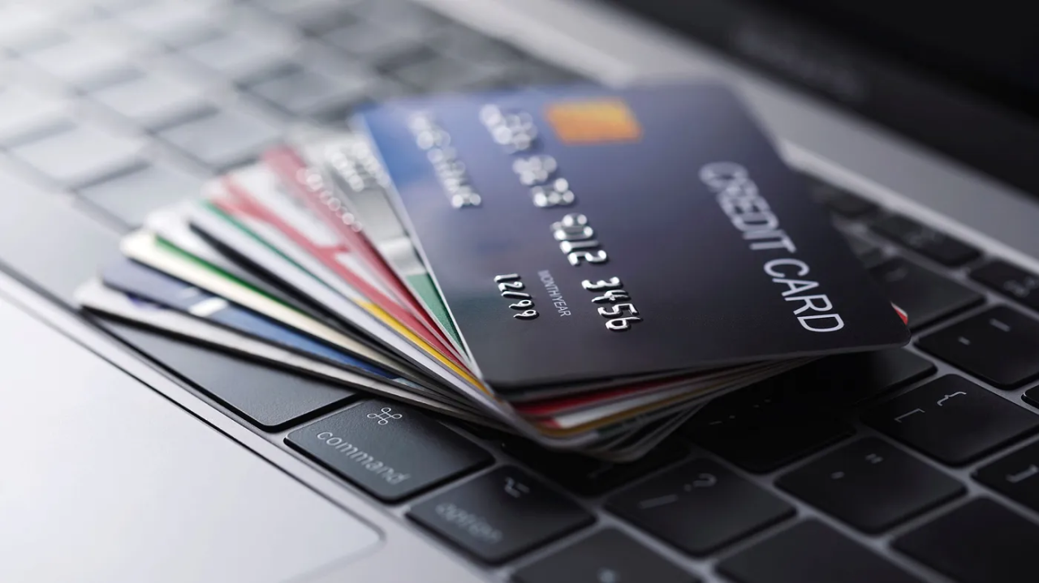
Credit Card Data Analysis and Visualization
Insights and Strategies for Credit Risk Management
NAME : P . GOUTHAM

Slide 2
This project focuses on analyzing the credit behavior of individuals using the provided credit card dataset.
Preprocess and clean the dataset: Ensure data integrity by handling outliers, missing values, and normalizing key financial variables.
Visualize key financial insights: Use data visualization tools to reveal trends in debt ratio, payment behavior, and customer segmentation.
Recommend strategies to improve credit risk management: Propose actionable solutions for better customer profiling, risk assessment, and tailored financial offerings.

Slide 3
Data Preprocessing Techniques for Credit Card Analysis
Outlier Detection: Utilized Interquartile Range (IQR) to identify extreme values in credit card data, such as Monthly Income, Debt Ratio, and Number of Dependents.
IQR Calculation: Computed Q1, Q3, and IQR to establish upper and lower bounds for key financial attributes, ensuring a robust approach to outlier detection.
Outlier Handling: Implemented the Capping Method to replace extreme outliers with the nearest valid boundary. This approach preserved the integrity of the dataset while reducing skewness and avoiding loss of critical data points.
Data Normalization: Adjusted values like Monthly Income and Debt Ratio to remain within a reasonable range, maintaining dataset consistency and preparing for accurate analysis.

Slide 4
Dataset Overview :
Demographics & Financial Data: Includes Monthly Income, Debt Ratio, Age, Dependents, and Credit Lines.
Key Attributes: Debt Ratio, Delinquency History, Occupation, and Education.
Purpose: Used for credit risk assessment, customer segmentation, and financial decision-making.
Visualization: Trends in credit behavior and regional analysis through dashboards and maps.

Slide 5
Visualizations Using Power BI:
Overview Dashboard – Displays total menu items and key nutritional statistics.
Caloric Analysis – Uses bar charts, pie charts, and heat maps to show calorie distribution.
Beverage Contribution – Compares sodas, coffees, and other beverages' impact on calorie intake.
Nutritional Comparisons – Evaluates grilled vs. crispy chicken and egg whites vs. whole eggs.

Slide 6
Good Customers:
Personalized Offers:
Provide rewards such as lower interest rates and cashback options.
Offer pre-approved loans and credit line increases to encourage loyalty.
Enhanced Services:
Grant priority customer service to build stronger relationships.
Design exclusive financial products for high-creditworthiness individuals.
Retention Strategies:
Use loyalty programs and personalized marketing to retain these customers.
Offer flexible repayment options to encourage continued responsible behavior.

Slide 7
Bad Customers:
Risk Mitigation:
Implement stricter borrowing limits to reduce exposure.
Monitor accounts more closely to detect early signs of delinquency.
Credit Education:
Provide financial literacy programs to improve budgeting and payment habits.
Send reminders and updates about payments to avoid defaults.
Recovery Strategies:
Offer debt restructuring or consolidation plans to manage repayment.
Introduce higher penalties for late payments to discourage repeated delinquency.

